Slide 1
Online real estate management system

Slide 2
ABSTRACT
Aim of this project was to develop a real estate web application using people. The real estate system Give the functionality for buyers,sellor allowing them to search for houses by features or address. It provides functionality for the seller, authorize them to log into the system and add new advertisements or delete existing ones. For this each user is provided a login account with login ID and password.

Slide 3
iNTRODUCTION
Whenever searching is done for a new house, the main focus is on the location. As location being a spatial entity we are using the advantages given by spatial databases for our application. The application provides the user to select any particular location and get information appropriately .There are some important issues in developing the real estate web application. First, the search time should be minimum. This depends on 2 techniques. Second, the web application should give the services that both buyer and seller want. Third, the web application should have a friendly user interface.

Slide 4
EXISTING SYSTEM
The present system is not dunce proof and has certain drawbacks. Being a manual system the possible limitations and loopholes in the present system is large. Some of them are human resource the current system has too much manual work from filling a form to filing a document, delivering manifesto. This increases burden on workers but does not yield the results it should in current system if any modification is to be made it increases manual work and is error prone.As the system is managed and maintained by workers errors are some of the possibilities.

Slide 5
PROPOSED SYSTEM
We used two different distance function one without unstructure text and second with during our experimentation we found advantage of combining both unstructured and structured data. In First distance function we computed distance by introducing a relative weight factor w. The normalization of data enables relative importance of some features in datum. For example, while clustering Type of property should be same that is, all "Apartments" are clustered together. As name suggest Fuzzy this distance function computes weights dynamically based on fuzziness1.

Slide 6
ADVANTAGES
They should be able to login with their id, name.
They should be able to give the exam as per the details entered by respective admin.
User friendly.

Slide 7
DISADVANTAGES
Reducing the manual labour (Decreases Overheads).
Avoiding Mistakes Due To Human Error (Accurate).
Will Increase Efficiency and Save Time.

Slide 8
HARDWARE AND SOFTWARE SPECIFICATION:
Software Requirement:
1. Language - Java(JDK 1.7)
2. OS - Windows 7 32bit
3. MySql Server
4. NetBeans IDE 7.1.2

Slide 9
Hardware Requirement :
1. 1 GB RAM
2. 80 GB Hard Disk
3. Above 2GHz Processor
4. Data Card

Slide 10
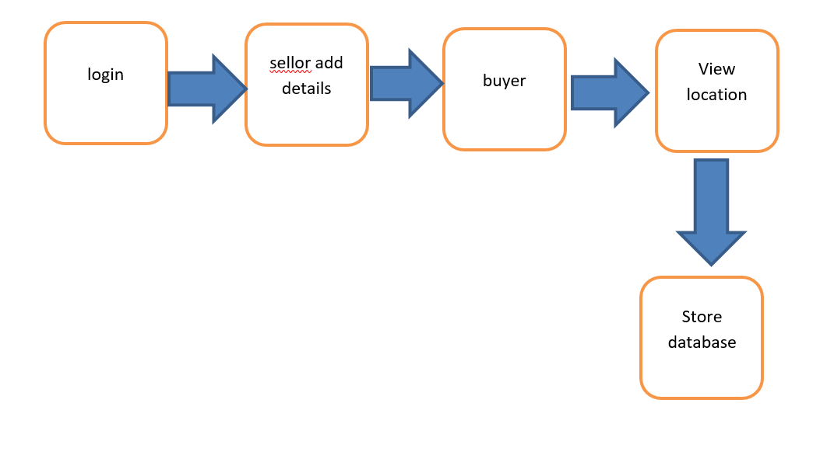
BLOCK DIAGRAM

Slide 11
CONCLUSION
As far as design is concerned no design is complete ever and there are chances of improvement each moment. However performing all the necessary testing, we will conclude that our design will implement properly that it absolutely was made.

